Slide 1
STAY INDEPENDENT.
Prevent Falls.
Presented By:
Position:
Organization:
Date:
Notes:
Add name of presenters and date to slide. Introduce self.
Focus of today’s presentation is on maintaining your independence and mobility by finding balance and preventing a fall before it happens.
All source available upon request to: ipc@ualberta.ca
Suggested handouts to support the presentation:
Resources that can be ordered from the Finding Balance website at: http://www.findingbalancealberta.ca : NEW Finding Balance Brochures (contact IPC to order more); Falls Risk Self-Assessment Checklist – PAMPHLET and a POSTER of Everyday Exercises for Older Adults (contact IPC to order more);
Resources that can be downloaded from the Finding Balance website at: http://www.findingbalancealberta.ca : How to Get Up from the Floor – English (also available in 13 different languages including English, French, Traditional Chinese, Simplified Chinese, Korean, Polish, Punjabi, Russian, Serbian Croatian, Spanish, Tagalog, Urdu, Vietnamese); Everyday Exercises for Strength and Balance Poster; Info-graphic; Information sheets on Keep Active , Have your Vision Checked and Review Your Medication; Foot Wear Foot Care Tips for Seniors; Ideal shoe; Getting a Good Night’s Sleep; Getting Around in Your Community; Getting Around In Your Home; Nutrition; Dizziness; Walking in Winter; Depression, Challenge Your Strength & Build Your Balance, and materials to support Campaign 2018.
My MedRec Booklet (download the free app from www.knowledgeisthebestmedicine) Printed booklets no longer available (Cited: October 4, 2016)
NOTE: Check with venue presenting at such as Seniors Centre/Lodges, regarding activities offered and procedures for what to do if a fall occurs

Slide 2
What do they have in common?
Notes:
Recognize these people? Have audience supply names: Nancy Reagan, Former Pope Benedict XVI, Steven Tyler, Hillary Clinton, Fidel Castro, the Queen of England
What do they have in common?
All these people have had serious falls – from broken arms to broken hips to concussions and head injuries – a fall can have devastating consequences and significantly affect one’s quality of life.

Slide 3
Falls Stories
Notes:
Ask: Who has ever tripped or slipped or … fallen? (Have them raise their hands to respond. ) Would anyone like to share your story? (get 3-4 stories)
What happened?
Did you get hurt?
When we talk about falls we are referring to losing your balance and ending up on the ground or lower level. Some people may call it a fall, some a trip or some a slip. You might end up hitting the wall or furniture or landing on the stairs. You may or may not get hurt.
The definition of a fall is “unintentionally coming to rest on the ground, floor or other lower level with or without an injury” from Canadian Falls Prevention Curriculum, 2007.
Falls can happen anywhere, anytime as you have shared - in the bathroom, on the stairs, walking outside, rushing to get the phone etc. with or without an injury
Falls can result in serious injury. After a fall you may feel dizzy, drowsy, or have new aches and pains and symptoms may appear the next day. See a health care provider right away. (FB Brochure, 2016)

Slide 4
Seniors’ Falls Facts
(Injury Prevention Centre. Seniors falls infographic 2018; Edmonton, AB: Injury Prevention Centre; 2018.)
Notes:
Created at IPC: REV: 09-2018
Anyone can fall, but as we age the risk increases
If you look to your right and now to your left, one of you will probably fall at least once this year.
Falls are not a normal part of aging

Slide 5
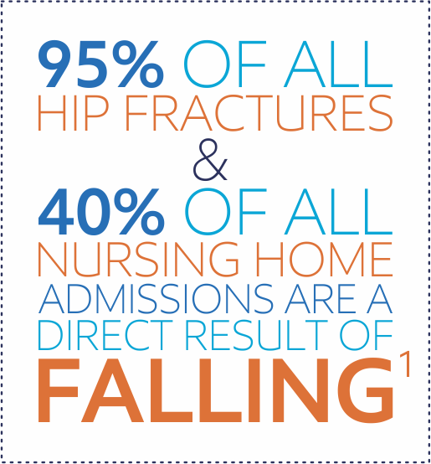
Seniors’ Falls Facts
(Injury Prevention Centre. Seniors falls infographic 2018. Edmonton, AB: Injury Prevention Centre; 2018))
Notes:
We know that:
95% hip fractures are a result of a fall
40% of nursing home residents are there because of a fall
Created at IPC: REV: 09-2018

Slide 6
Alberta Seniors’ Injury Hospital Admissions
(Injury Prevention Centre. Seniors falls infographic 2018. Edmonton, AB: Injury Prevention Centre; 2018)
Notes:
Falls are the leading cause of injuries amongst seniors (>65 years).
This graph shows us that if a person over 65 is admitted to hospital because of an injury, the most common reason for that injury will be a fall.
Minor injuries include bruises or sprains and typically people do not seek medical attention for these.
Serious injuries include head injuries, fractures, lacerations.

Slide 7
Seniors’ Falls Facts
If you fall once, you are more likely to fall again
Women are 3 times more likely than men to be hospitalized for a fall-related injury
Men are more likely to die from a fall-related injury
Notes:
Women are 3 times more likely than men to be hospitalized for a fall-related injury, and men are more likely to die from a fall related injury.
Contributing factors could include age-related frailty, restricted mobility, more frequent use of multiple medications, and increased incidence of osteoporosis. Men are more likely than women to experience fatal falls. It may be that men are more physically active or more likely to engage in risky behaviors such as gender-based tasks like cleaning our the leaves from the eaves troughs or shoveling snow. For more information about osteoporosis, please consult the Osteoporosis Canada website at: http://www.osteoporosis.ca/ )
Most important thing is that falls are NOT a normal part of aging.

Slide 8
After a fall, you may…
Lose confidence
Be afraid you might fall again
Stop going out and doing things you enjoy
Notes:
Bullets phase in…
Ask: For those of you who have had a fall, how did you feel after? Has the fall affected your life and what you do??
Even if you haven’t hurt yourself, there are other things that can happen. Some people lose their confidence in their ability to get out and about. Some people become afraid that they’ll fall again which results in them not going out and doing things they enjoy, becoming isolated, not exercising.
Ask: Has this (loss of confidence, feeling afraid, not wanting to go out) happened to any of you?
If you do less, it becomes a slippery slope. The less you do, the weaker your muscles become and the poorer your balance which increases your chances of falling again.
“If you don’t use it, you lose it.”

Slide 9
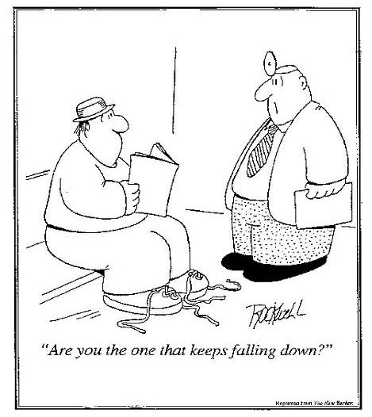
Notes:
Describe cartoon and read caption.
FALLS DON’T JUST HAPPEN – most falls can be prevented.

Slide 10
What causes a fall?
Notes:
Ask: What do you think can cause a fall? Get audience participation.
(Already identified some of the causes from your stories.)

Slide 11
Risk Factors
Risk
Taking
Home
Safety
Blood Pressure
Depression
Leg Strength
Balance
Stroke
Parkinson’s
Vision
Footwear
Nutrition
Dizziness
Bathroom
Medication
Notes:
People fall for a variety of reasons and these reasons are called “risk factors”.
If you know your risk factors, you can take action to reduce your chance of falling.
Falls have many causes. Go through the puzzle pieces, identifying ones that have been discussed and touching upon new ones.
Some risk factors you can change. For example, you can make changes to your footwear, your home, eating balanced meals, etc.
Some risk factors cannot be changed (not modifiable). For example, you can’t change your age, some medical conditions and medications. So, you need to learn how to prevent falls in spite of these risk factors. Check with your healthcare practitioner.
NOTE: you can tie in these with the stories told on the earlier slide.

Slide 12
Notes:
The risk of falling increases as the number of risk factors increases. For example, with no risk factors, there is only an 8 % risk of falling but with 4 risk factors, there is a 78 % risk of falling.
That is why it is so important to know your risk factors and the actions you can take to prevent a fall from happening to you.
Make lifestyle choices that will help you look, feel, and move better.

Slide 13
TAKE ACTION
Be active
Have your vision checked
Review your medications
Notes:
The good news is that there are many things you can do to prevent falling.
We are going to focus on 3 key actions you can do to prevent a fall.
The 1st key action to help prevent a fall is ‘Be active’
Show Handout: Be Active
Activity will help you feel better, sleep better and help keep you independent.

Slide 14
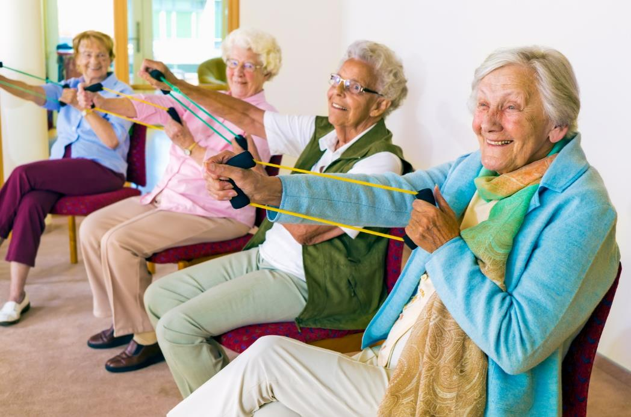
Be active to improve your strength and balance.
Notes:
Ask: What are some of the benefits of being active?
Keeps your bones and muscles healthy and strong and improves your balance
Improves your balance
Keeps your heart and lungs healthy
Increases your energy
Helps you sleep
Reduces the fear of falling
Helps to reduce the risk of chronic diseases like heart disease and high blood pressure
Improves memory and attention
Improves mood and sense of well-being

Slide 15
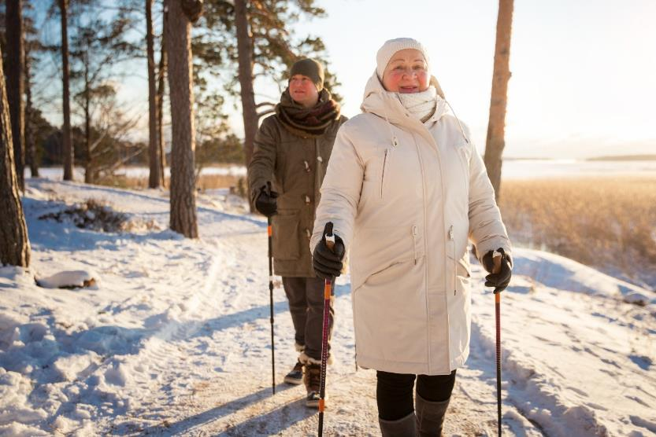
Warning
As an older adult, regular physical activity is one of the most important things you can do for your health. (CDC, 2016)
Notes:
As an older adult, regular physical activity is one of the most important things you can do for your health. It can prevent many of the health problems that seem to come with age. It also helps your muscles grow stronger so you can keep doing your day-to-day activities without becoming dependent on others.
Many chronic diseases are linked with inactivity such as: heart disease, stroke, depression, high blood pressure, colon cancer, type 2 diabetes, early death and osteoporosis. Research indicates that as physical activity improves heart function, oxygen levels to the brain are increased, which has the potential to decrease cognitive problems such as dementia
If you’re concerned about injuring yourself, or if you have arthritis, or a heart condition, talk to your healthcare provider about activities that are good for you. Remember the risks of being inactive.

Slide 16
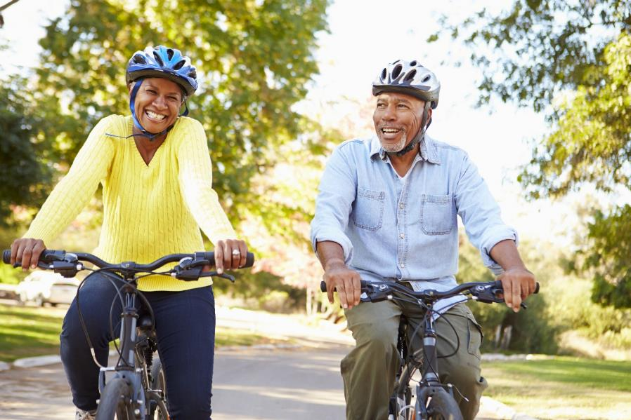
Be Active
Aim for 30 minutes every day for at least 5 days each week
Notes:
Physical activity can be anything that moves your big muscles and increases the amount of energy that you use.
Try to do 30 minutes or more of moderate to vigorous intensity physical activity at least 5 days each week
Moderate-intensity: you will sweat and breathe harder
Vigorous-intensity: you will sweat and be out of breath
While you want to aim to be active for 30 minutes, you can break the time down. The Canadian physical activity guidelines suggest being active in blocks of 10 minutes or more, while another review of literature suggests to see benefits 30 minutes is needed
Ask: Does anyone break their exercise into smaller chunks of time already? If so, how? (Examples might be to walk for 10 minutes 3 times a day, or walk 15 minutes at the mall with friends before coffee and then gardening in the afternoon for 15 minutes.)
NOTE: If you are doing this presentation in a senior’s centre or other setting, try to highlight activities the centre offers.

Slide 17
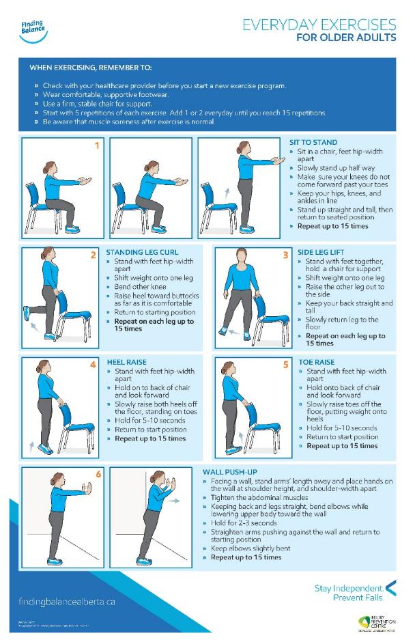
Notes:
Show: Finding Balance Strength and Balance Poster (Available to order on the Finding Balance Alberta website)
Ask: What are some reasons for not being active? What are some barriers to getting active? (E.g. Access, I’m too old, I’ve worked hard all of my life , cost - some things are free e.g. walking, walking the dog, mall walking. Some things are subsidized e.g. YMCA.)
If you’ve never been involved in an activity before, many places like the YMCA, fitness centres and senior’s centres have try-it-out sessions.
Try to build in a reward for yourself. We all need to know we’ve accomplished something good for ourselves.
Ask: What activities do you do? (Examples are: golfing, walking, bowling, dancing, lawn bowling, swimming, gardening, tai chi, pole walking.)
For balance, try: Exercises in a standing position or tai chi
For strength, try: Wall push-ups, stair climbing or exercises with weights or bands.
For endurance, try: walking, dancing, gardening, bicycling, cross-country skiing or swimming.
For flexibility, try: stretching, yoga or tai chi.
NOTE: Have local resources available – e.g., Physical Activity and Recreation Directory for Older Adults

Slide 18
Be Active
Be safe. Talk to your healthcare provider before starting something new.
It doesn’t matter what age we are, our bodies will get stronger if we are active.
Notes:
Talk to a healthcare professional before beginning a new activity or exercise program to be sure it’s right for you.
If you are just getting started, build up slowly and add a few minutes each day. Include activities that strengthen both arm and leg muscles.
It doesn’t matter what age we are, our bodies will always get stronger if we are active.
Demonstrate: some or all of the following examples of exercises to help with strength and balance. Encourage the participants to join in:
Sit to Stand – In a firm chair, sit near the front. Bring feet closer to chair, use arm rests if needed, lean forward and stand up. Stand tall for a few seconds then slowly lower yourself to sit down. Do this 5x. Gradually try to reduce the amount of support through your hands and increase the number of repetitions to 15.
Sink Exercises - While standing at the sink keep your toes pointing forward and your body straight (don’t lean forward, backward or sideways) , lift one leg out to the side (~1 inch) – hold up to 5 seconds and lower leg 5x. Then do with other leg. Do more reps, reduce amount of support but always stay close to the counter just in case.
Also do with leg behind you.
Demonstrate and people can join in: You can encourage everyone to stand up and do a basic exercise, or stand up and stretch. To reinforce it, people could sing “My Bonnie Lies Over the Ocean” and every time you sing a word with “B” you either raise onto your toes, or lower back to your feet. Ensure that people either hold onto a steady chair or table, or that their hand hovers over it when doing this demonstration.

Slide 19
TAKE ACTION
Be active
Have your vision checked
Review your medications
Notes:
The 2nd key action to help prevent a fall is ‘Have your vision checked’
Show Handout: Have your vision checked

Slide 20
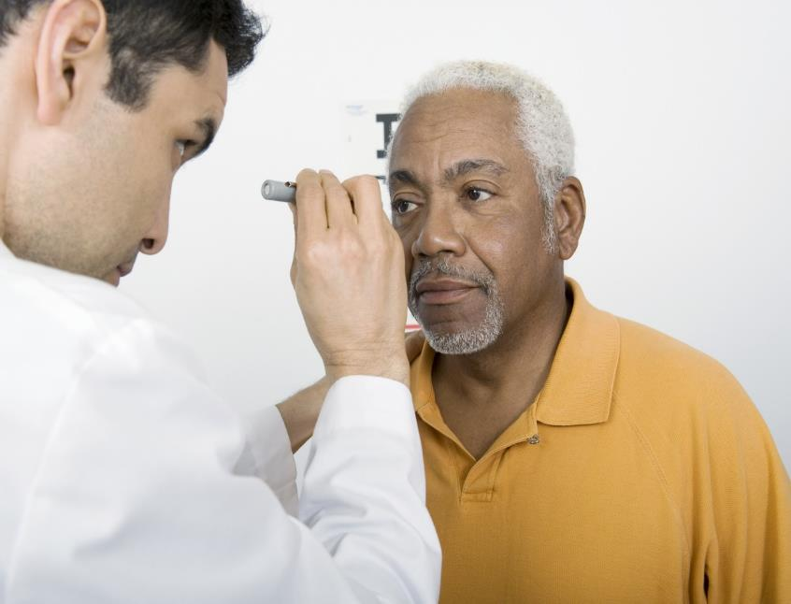
Visit your eye doctor every year for a complete eye exam.
Notes:
As you age it is important to visit your eye doctor (optometrist or ophthalmologist) for a comprehensive eye exam every year and to talk about your eye health and any changes to your vision.
Ask: What are some changes to your vision that may increase your risk of falling?
Some changes may increase the risk of falling, such as:
Eyes take more time to adjust to changes in light or glare.
May be harder to identify objects, especially at night.
Harder to judge the distance from objects. We need this depth perception when we are going up and down stairs and curbs.
You may develop eye conditions, such as, cataracts, glaucoma, macular degeneration that reduce vision.
We become more sensitive to glare
We need more light to see at night.

Slide 21
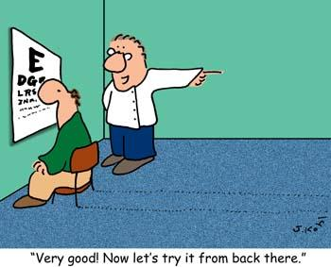
Check Your Vision
Talk about your eye health and any changes to your vision.
Notes:
Ask: Who wears bifocals and multifocals?
With multifocals, the points where the prescription changes, you don’t always get clear vision. So be careful when on stairs and curbs. You may need to tip your head down and look out of the top to see better.
When you get new glasses give yourself time to get used to them. Especially on stairs and curbs where the change in prescription isn’t the same as the previous glasses, it can be hard to see the edges of stairs and curbs.
Please remember to clean your glasses frequently
Talk to your eye doctor about adjusting to new prescriptions.

Slide 22
Check Your Vision
Older adults with low vision are 2.5 times more likely to fall
Wear sunglasses, even in the winter
Eye exams for Albertans 65+ are covered by Alberta Health
Notes:
Older adults with low vision are 2.5 more times likely to fall
Alberta Health Care covers the cost of eye exams for Alberta adults who are 65+

Slide 23
TAKE ACTION
Be active
Have your vision checked
Review your medications
Notes:
The 3rd key action to help prevent a fall is ‘Review your medications’.
Show Handout: Review your medication

Slide 24
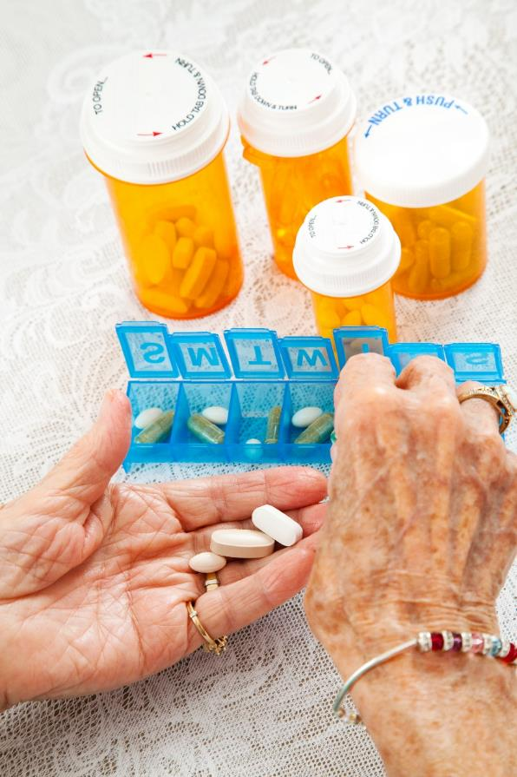
Review all your medications with your doctor or pharmacist.
Notes:
As you age your health needs may change, you may take more than one medication or supplement to stay healthy. It’s important to review your medications with your doctor or pharmacist.
Ask: How many medications are you, or someone you know, currently taking?
Most seniors in Canada are taking at least 5 drugs. Drug use increases with age, with more than 40% of Canadians age 85 and older taking more than 10 drugs.
The more medications you take, the greater your risk of falling. Those people taking 3-4 or more prescription medications have a higher risk of falling than those taking fewer medications.
The type, duration and dosage of different medications can also increase the risk of falling.
As we age, the way some medications work and/or are handled by the body can change. Some of these changes may increase the risk of falling.
These reasons support why it’s so important to have your medications checked

Slide 25
Review Your Medications
Medications include:
Prescriptions
Supplements
Over-the-counter medications
Vitamins
Notes:
Medications include more than what your doctor prescribes. Medications include vitamins, supplements and over the counter drugs such as cough syrups, cough medicines, and pain killers.
Ask: Does anyone have osteoporosis? Osteoporosis is a bone disease where bones become thin and brittle making them more likely to break.
Vitamin D:
Osteoporosis Canada recommends routine vitamin D supplementation for all Canadian adults year round, 800 – 2,000 IU daily.
Show: examples of vitamin D bottle
Calcium:
For those over 50, Canada’s Food Guide recommends 3 servings of milk and alternatives– yogurt, cheese, calcium-fortified beverages, puddings, custards, etc or 1200 mg daily. This essentially means that you need the equivalent of one good serving of dairy at each meal.
Osteoporosis Canada strongly recommends that everyone obtain their calcium through nutrition whenever possible. Calcium supplements can have some side effects and have been associated with some risks. Excess calcium from supplements has been associated with kidney stones, heart problems, prostate cancer, constipation and digestive problems. Do not take extra calcium from supplements if your diet is already giving you enough calcium – follow your doctor’s advice. Osteoporosis Canada. How do I know if I need a calcium supplement? [internet]. Canada: Osteoporosis Canada. 2017 [cited 2017 Oct 25]. Available from:http://www.osteoporosis.ca/osteoporosis-and-you/nutrition/supplements/

Slide 26
Review Your Medications
Medications that relax you, help you sleep, or improve your mood can increase your risk of falling.
Use only 1 pharmacy and never take someone else’s medications.
Alcohol affects medication – be careful.
Notes:
Good medication habits that can help you stay healthy and independent:
Always follow the instructions and doses when taking medications.
Keep a current medication list in your wallet and at home.
Do not share prescription medications.
Show: a sample medication booklet/list. Can also get a printout from their pharmacist or My MedRec Booklet (download the free app from www.knowledgeisthebestmedicine) Printed booklets no longer available (Cited: 2016 October 4)
Return outdated medication to your pharmacist.
Ask your pharmacist about pill packs if you, or someone you know, are having trouble remembering whether the pills have been taken at the correct times.
Ask: Where do you get your medications? How are they packaged?
Show: blister pack and/or dosette.
As we age, our bodies do not break down alcohol as efficiently so it is best to minimize the use of alcohol as even a small amount can increase the risk of falling. The combination of having a nightcap and a sedating medication like a sleeping pill is particularly risky. If you are unsure about whether it is safe to drink alcohol with your medication, speak to your doctor, pharmacist or nurse practitioner.

Slide 27
Review Your Medications
Notes:
A pharmacist, doctor or nurse practitioner should check your medications at least once a year or when you have a change in medication.
Ask: How many of you have your medications reviewed at least once a year?
Ask: What are questions to discuss with your doctor or pharmacist?
Suggested questions about all prescriptions, over-the-counter medications, vitamins and herbal supplements
What is the medication used for?
Will it cause dizziness or drowsiness as a side effect?
Will it cause blurred or double vision?
What should I do if I have side effects?
What should I do if I miss a dose?
Should I avoid alcohol or other foods or beverages?

Slide 28
Your Surroundings
Pay attention to what is in your path. Everyday objects inside and outside your home can cause a fall.
Notes:
Many of the items inside and outside your home are hazards that can be easily fixed.

Slide 29
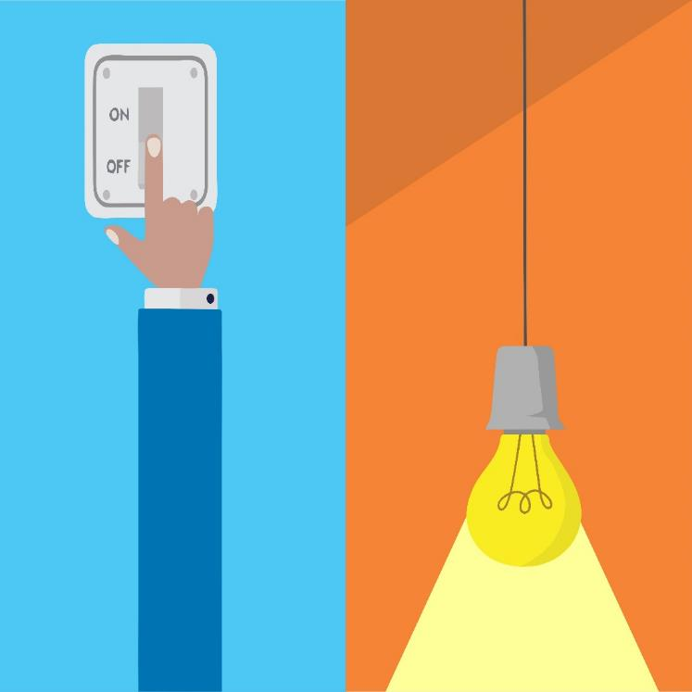
Your Surroundings
Use bright lights and nightlights inside your home. Use motion-sensing lights outside.
Notes:
Use bright lights and nightlights inside your home, especially in the bathroom and hallways.
Use nightlights and motion sensor lights inside and outside.
Keep rooms well lit.
Use high wattage bulbs and replace burned out light bulbs.
Mark the edge of stairs with coloured paint or treads.
Keep lighting similar in every room.
Give your eyes time to adjust to changes in light.
Ensure you have a light by your bed.
Have light switches at the top and bottom of the stairs, if possible.
Show: a night light - especially important to use if you get up during the night. Can have the ones that are light sensitive or motion sensitive.
Show: Outdoor motion sensitive lights to light pathways and stairs is also helpful.

Slide 30
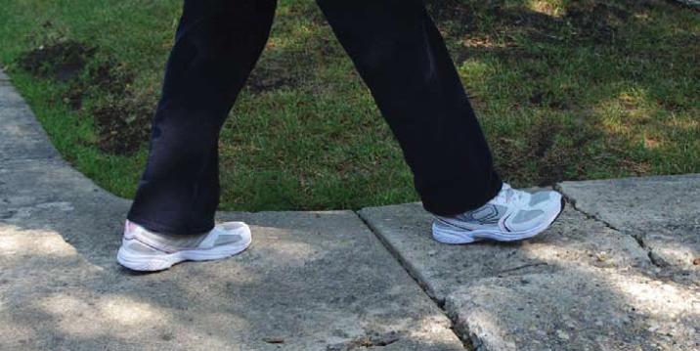
Your Surroundings
Watch your step!
Notes:
Watch your step wherever you are – inside and outside, at home and in public buildings, the library, the mall, seniors centre.
Ask: What are the potential hazards in this photo? Does this photo look familiar in your neighborhood?? Discuss the potential hazards and what to do in communities (i.e., sidewalk cracks, high curbs, etc.) For example, calling the city/town, your landlord, or staff to address the issue.
Watch out for ice, uneven surfaces, cracks in the sidewalk, and outdoor items like the garden hose

Slide 31
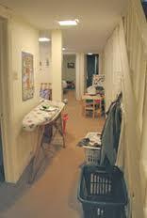
Your Surroundings
1
2
Photos Courtesy of Queensland Stay On Your Feet®
Notes:
Ask: What is hazardous in these pictures? (L to R)
Picture 1: People can catch their toes on throw rugs or slip and fall. Use non-slip mats or rugs.
Picture 2: Hallway – baskets, ironing board. Pathways should be clear and free of furniture, cords and objects including rugs, cords and toys, especially high traffic areas such as hallways and paths to the bathroom. Also watch out for pets.

Slide 32
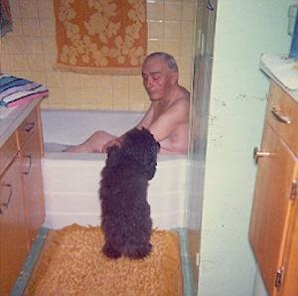
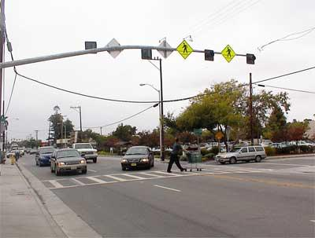
Your Surroundings
1
2
Photos Courtesy of Queensland Stay On Your Feet®
Notes:
Ask: What is hazardous in these pictures?
Picture 1: No grab bar – don’t ever use towel bar as it is not designed to support your weight. Stepping out of the tub is a frequent time for falls and injuries to occur. Other hazards include: dog in the way, bathroom mats.
Use non-slip mats or rugs. Replace mats if they lose their stickiness and can be moved when stepped on.
Demonstrate: non-slip map
Show: tub/shower mat with suction cups. Recommend the longest bath mat to cover the greatest surface.
Use non-slip mats and grab bars in the bathroom.
Picture 2: Crosswalk – large, busy intersection to cross – may rush to cross. If you have mobility issues or aids, it will take longer. Be sure to allow enough time to cross the road. Cross at the same pace.

Slide 33
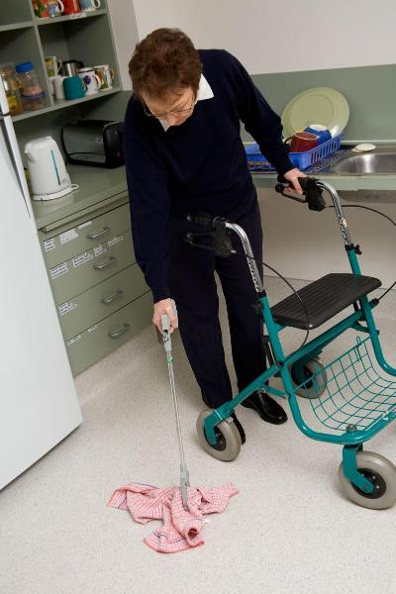
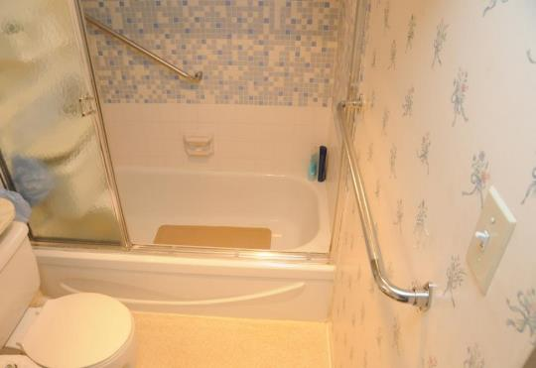
Your Surroundings
Install grab bars for your tub, shower, and toilet.
Use the right equipment
Photos Courtesy of Queensland Stay On Your Feet®
Notes:
It’s important to have the right equipment in your home and the appropriate walking aids, if applicable.
It’s important that walker/cane is fitted correctly for you. Talk to your health care provider about using a cane, walker, or other mobility aids. It may be a physiotherapist, occupational therapist or nurse.
Demonstrate: Reacher - If balance is a problem there are many items that can help. Use a “Grabber/Reacher” to pick things up that are hard to reach or use a shoe horn to put on shoes. Of course, exercises that are aimed to increase balance are recommended as well.
Show: extended shoe horn
Hip protectors have been shown to help reduce the severity of injury in residential care if worn properly. Hip protectors - show and discuss use of hip protectors. Show: hip protector

Slide 34
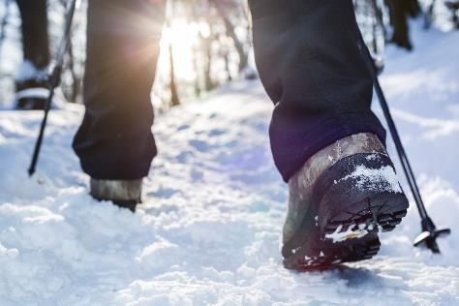
Getting Around
Move with ease and confidence with these tips.

Slide 35
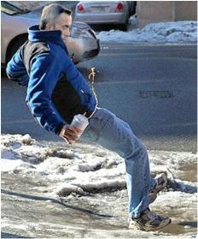
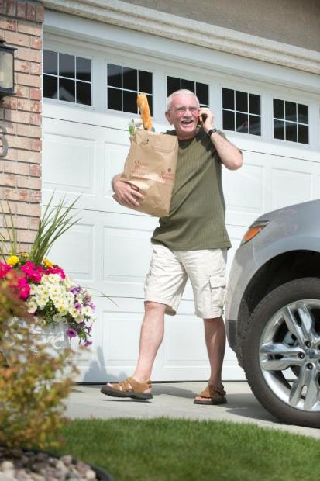
Getting Around
Take your time and focus on what you are doing.
Notes:
Take your time and focus on what you are doing.
Ask: What’s wrong with these photos? Not paying attention, multitasking,
Stress importance of paying attention especially in unfamiliar settings – examples such as stairs, uneven flooring, weather, etc.
Winter:
When walking in winter - ice, snow and piles of snow become barriers to getting out and about.
Keep walkways clear of snow. There are snow removal programs such as ‘Snow Angels’ to help.
Add ice grips to your footwear in the winter
Can use ice melt or sand on your walks for traction.
Try to avoid walking over windrows, go around where possible.
Assume that a dark patch of sidewalk is slippery and/or wet.
Walk like a Penguin (Alberta Health Services)
Show:
Cane tip
Boot with ice grippers
Bag of sand for car or to carry with you.
Handout: Walking in Winter

Slide 36
Winter Walking
What can you do to prevent falling in winter?
Notes:
In winter:
Walk like a Penguin (available from Alberta Health Services website at: www.penguinwalk.ca)
Demonstrate: the Penguin Walk.

Slide 37
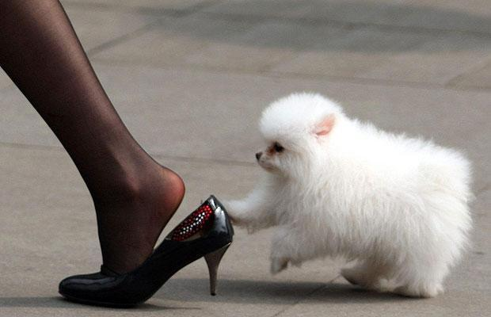
Getting Around
Notes:
Footwear can also play a role in preventing falls.
Ask: What’s wrong with this footwear? - heel too high, improper fit, dog is a tripping hazard too!
Even if wearing supportive shoes, still need to be careful and pay attention to your surroundings. (e.g. When walking into a mall, snow build-up can cause a slip.)
Check grip on winter boots to see if you need to consider a new pair.
Wear supportive, non-slip footwear inside and outside.
If needed, talk to your health care provider about using a cane, walker, or other mobility aids. Important that walker/cane is fitted for you. Could be fitted by a physiotherapist, occupational therapist or nurse that could assist.

Slide 38
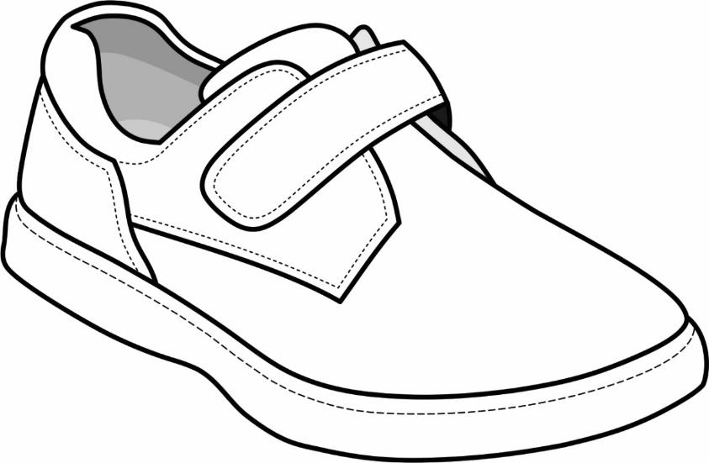
Heel cup is deep with a snug collar to provide support and prevent heel slipping
Laces or Velcro® closure allows a snug fit and room for swelling
Toe box is deep and wide
enough to allow toes to move
Heel is wide and flat to provide better side stability
Shoe length is no more than 7 mm (1/4") longer than your longest toe
Heel should be no more than 10 mm (3/8") higher than the toe
For better stability, the thickness of the midsole should not be thicker
than 25 mm (1")
Sole provides good grip but does not stick to carpet
Notes:
Wear supportive, non-slip footwear inside and outside.
Review components of ideal shoe
Have seniors check own shoes or show your own. Depending on your audience and time available, ask them to pair up and look at their own shoes to decide who has good shoes and ask where they were purchased., etc.
Stocking feet on certain flooring can also be hazardous.
Show:
Example of a good shoe, boot and/or slipper
Show example of non-slip socks
If time, use the Good or Bad? Shoe pictures
Handout: Ideal Shoe

Slide 39
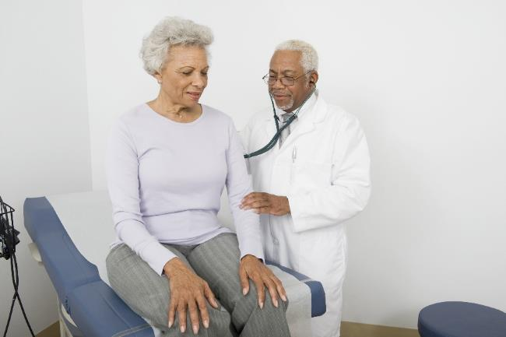
Speak Up About Dizziness
Tell your doctor and take action.
Notes:
Tell your doctor if you often feel dizzy or light headed. There can be many different causes of dizziness including: some medications, anxiety, depression, low blood sugar, problems with vision, inner ear problems, postural hypotension and dehydration.
Dehydration can be caused by medications such as diuretics or laxatives or some medical problems such as diarrhea, vomiting, heat stroke, high blood sugar, infections or excessive exercise.
ASK: Do any of you become dizzy when you get up?

Slide 40
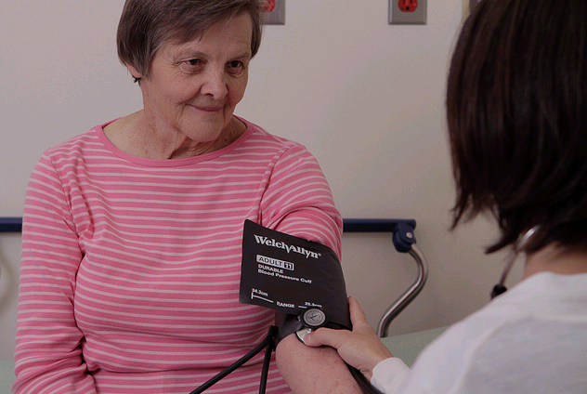
Speak Up About Dizziness
Have your blood pressure checked.
Notes:
Postural hypotension is a drop in blood pressure that happens when you get up from lying, sitting or bending over. This can affect how much blood gets to your brain and can make you feel dizzy, weak, lightheaded or may even pass out. This may cause you to fall.
Your health care provider should test your blood pressure with you laying down and standing up to determine if you have postural hypotension.
Not everyone with postural hypotension feels dizzy so it’s worthwhile getting it checked.
Mild physical exercise can improve blood flow. Speak to your doctor about an exercise program to reduce the symptoms of postural hypotension .
Drink 6-8 glasses or water or other fluid each day. If you have heart failure or are on water pills, talk to your health care provider about how much you should drink. (Clarify that it’s not 6 - 8 glasses of water plus other fluids, but a total of 6 - 8 glasses of fluids).

Slide 41
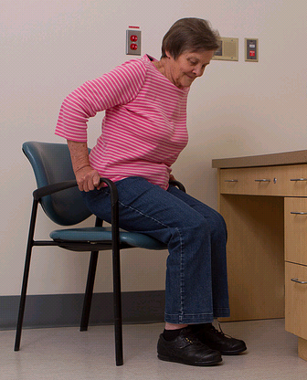
Speak Up About Dizziness
Before you get up:
Clench your fists and circle your ankles ten times
Rise slowly
Sit or lie down again if you feel dizzy or light-headed
Notes:
If you do feel dizzy when you get up, or if your healthcare provider has told you that you have postural hypotension, there are some things you can do.
Before getting out of bed or from a chair, clench your fists for half a minute. This helps to raise your blood pressure before you get up. If you have wrist pain, trying toe-raises or leg-crossing & flexing your leg muscles.
Demonstrate this.

Slide 42
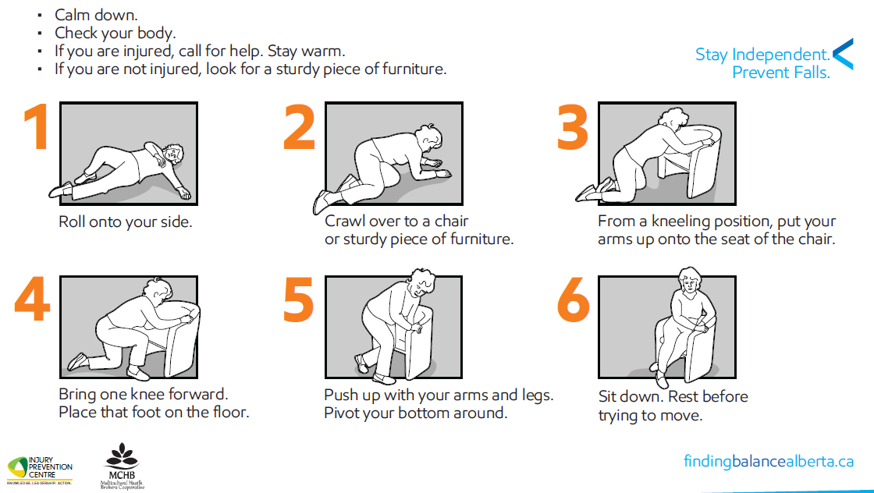
Notes:
Note: Check with staff where presenting re: their procedures when someone has fallen
How To Get Up from the floor by yourself after a fall.
It’s important to know how to safely get up from the floor if you have fallen and are NOT injured.
This document was created when EMS (ambulance service) visited the same woman 11 out of 13 days because she had fallen but didn’t know how to get up. She was never transferred to hospital because she was not injured. It is important to know how to safely get up.
PLEASE NOTE: Do not lift a person after they have fallen. You may hurt yourself or hurt the person who has fallen.
Demonstrate: How to get up from the floor.
Ask: Is there someone who would like to try this?
If you are injured and cannot get up, call for help. Consider an alert system or carry a phone with you.
Show Handout: How to get up from the floor
This resource is downloadable from www.findingbalancealberta.ca in multiple languages.

Slide 43
What if I have fallen?
Always tell your healthcare provider if you have had a fall
Find out about programs/services in your area
Finding Balance website findingbalancealberta.ca
Health Link Alberta 811
Notes:
Falls can result in serious injury. After a fall you may feel dizzy, drowsy, or have new aches and pains. See a health care provider right away!
Always tell your healthcare provider if you have had a fall. Falls can act as a red flag. It’s important to tell a healthcare provider so you can explore the reasons why you may have fallen and to prevent if from happening again.
Ask about programs in your area.
Refer to Health Link Alberta or Finding Balance website (www.findingbalancealberta.ca).

Slide 44
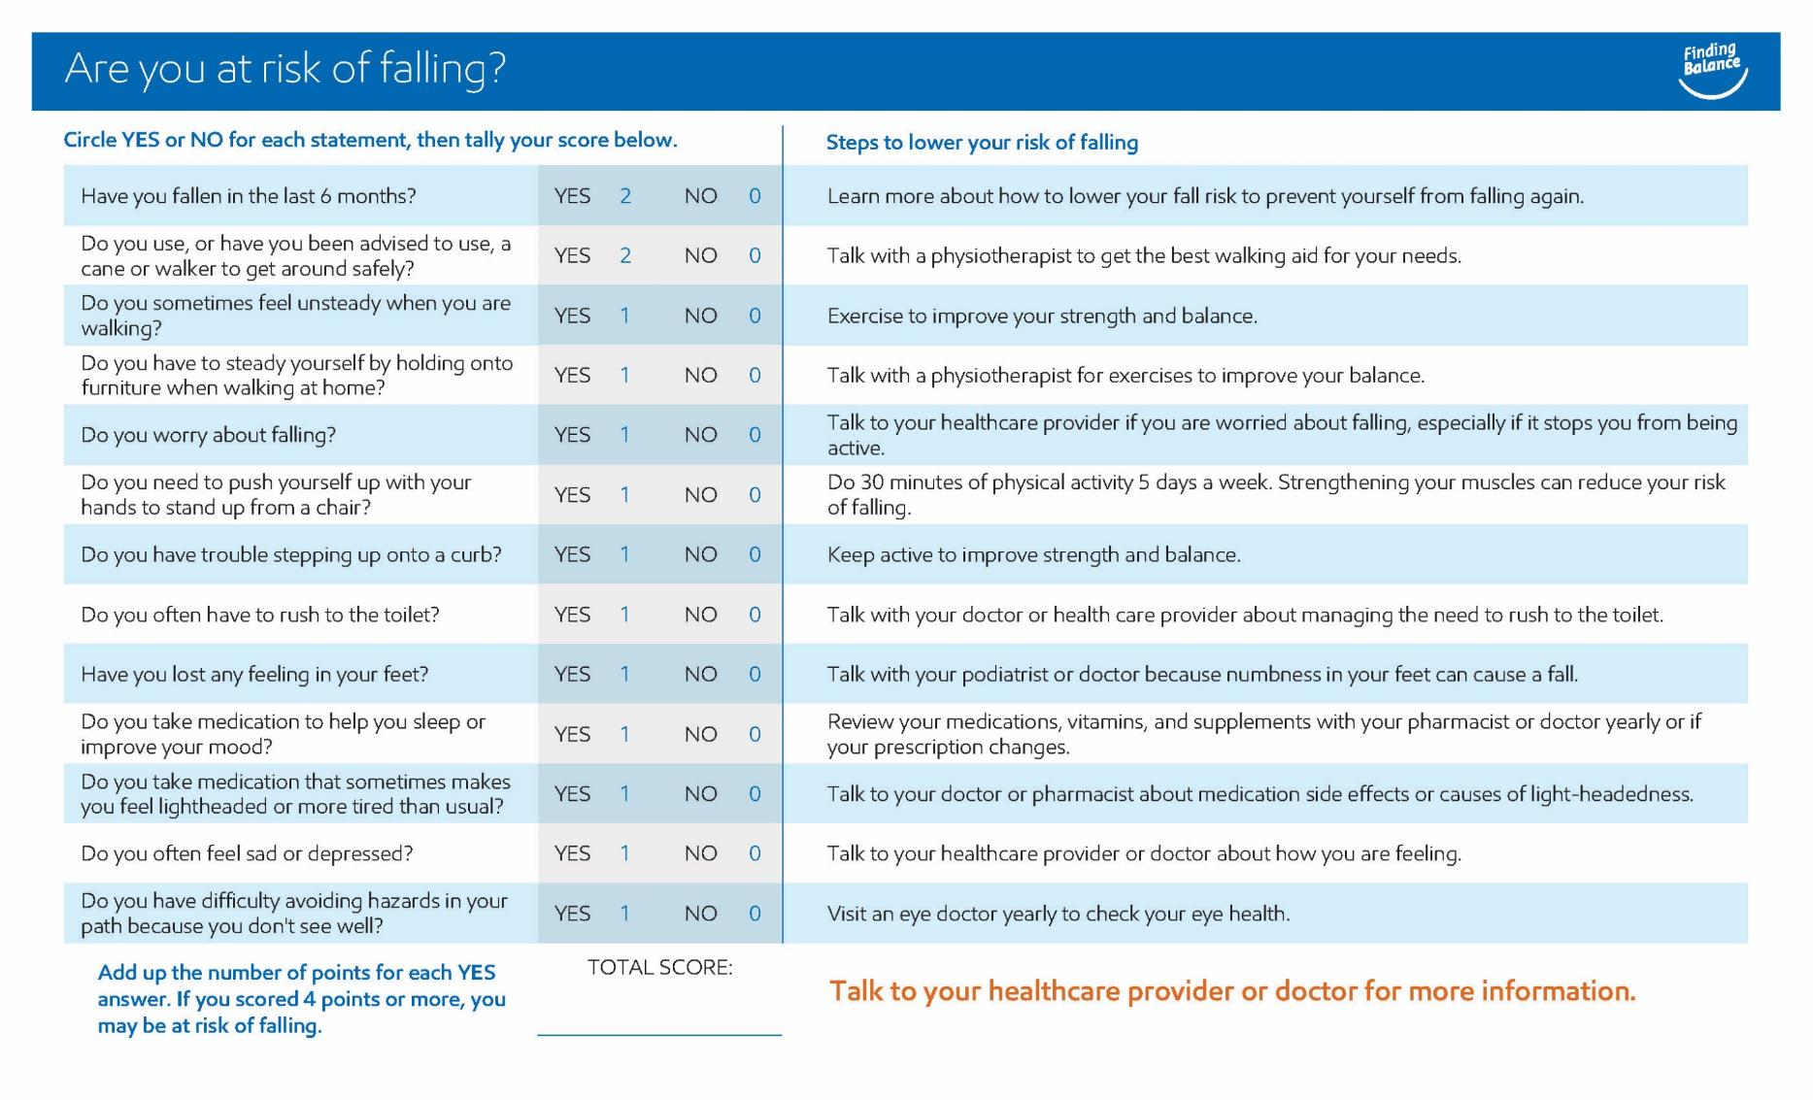
Notes:
Falls Self Risk Assessment – can be done individually at the presentation or at home
Say: You can complete the Falls Self Risk Checklist to see if you are at risk of falling and how you can stay safe.
Show Handout: Falls Self Risk Assessment (poster and/or checklist are available)
Have a copy of the checklist for them to complete

Slide 45
Stay Independent. Prevent Falls.
Many falls are preventable
Take action to prevent a fall
Strengthen your legs and maintain good balance
Identify your risk factors and make a plan
Tell your healthcare provider if you have fallen.
Notes:
Stay Independent. Prevent Falls.
The good news is that falls are not a normal part of aging and in fact many falls are preventable.
Take action to prevent a fall before it happens.
And always let your healthcare provider know if you have had a fall.

Slide 46
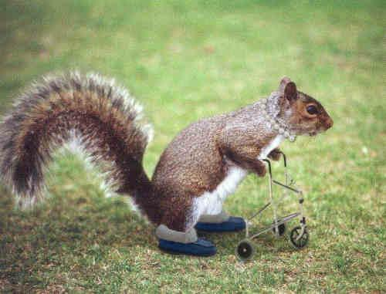
QUESTIONS?
Notes:
Thank you.

