Slide 1
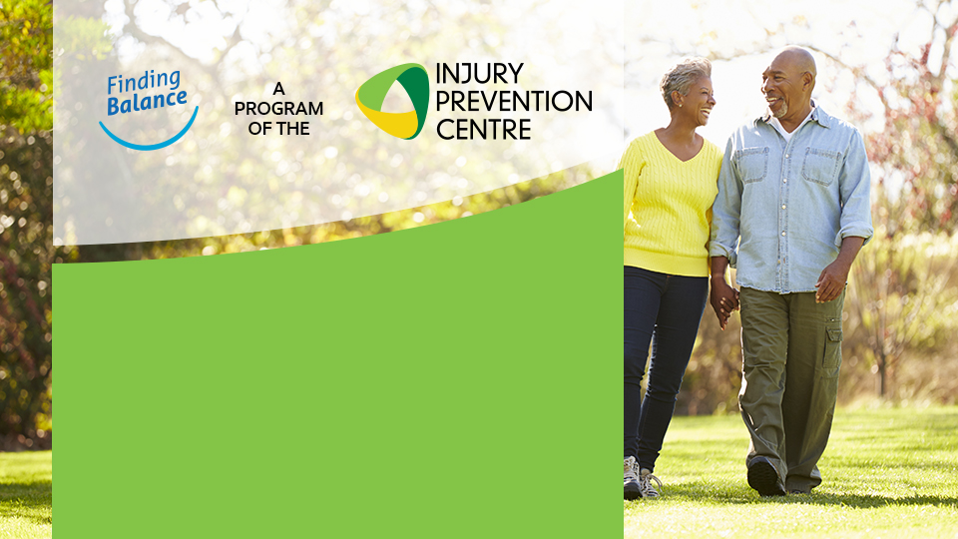
Space for Text

Slide 2
Could a fall
change your lifestyle?

Slide 3
20-30% of older Albertans fall each year.

Slide 4
After a fall, many are unable to live the way they want to.

Slide 5
The good news is you can reduce your chances of falling.

Slide 7
Challenge Your Balance
Balance is controlling your movements.
Practice movements like reaching while standing, toe and heel raises, stepping in different directions, step-ups or half-squats.
Try tai chi, yoga or sports that challenge your balance.

Slide 8
Build Strength
Do exercises for your leg muscles.
Use bands, weights or your own body weight.
Try squats, hamstring curls, and side leg lifts.

Slide 9
Be Active
Do activities you enjoy!
Try to do 30 minutes or more of moderate to vigorous activity or exercise at least 5 times per week.
Walk, dance, garden, bicycle, or swim.

Slide 10
No matter what your abilities are today,
you can improve your strength and balance.
Include strength and balance activities on most days of the week.
Supervised group programs can help you learn exercises and grow confidence.
People with strong legs and good balance are less likely to fall.
You’re never too old, or too young to start.

Slide 11
Are you at risk
of falling?

Slide 12
Have you fallen in the last 6 months?
Do you use, or have you been advised to use, a cane or walker to get around safely?
Do you sometimes feel unsteady when you are walking?
Do you have to steady yourself by holding onto furniture when walking at home?
Do you worry about falling?
Do you need to push yourself up with your hands to stand up from a chair?
Do you have trouble stepping up onto a curb?
continued…

Slide 13
Do you often have to rush to the toilet?
Have you lost any feeling in your feet?
Do you take medication to help you sleep or improve your mood?
Do you take medication that sometimes makes you feel lightheaded or more tired than usual?
Do you often feel sad or depressed?
Do you have difficulty avoiding hazards in your path because you don’t see well?

Slide 15
There are steps you can take to lower your risk

Slide 16
Your health care provider can help you identify reasons related to your health or environment that can cause you to fall.
Have your vision checked every year for changes to your eyesight, cataracts, and other conditions.
Medications for sleep, anxiety, and treating depression can make you dizzy or sleepy and unstable on your feet. Review your medications with a doctor or pharmacist. continued...

Slide 17
Supportive footwear and foot care can ease foot pain. In the winter, wear anti-slip devices on your footwear.
Make your home safer by removing tripping hazards, improve lighting. An occupational therapist can help.
If it seems you have fallen for no apparent reason, you may have a medical condition that needs to be addressed by a doctor.

Slide 18
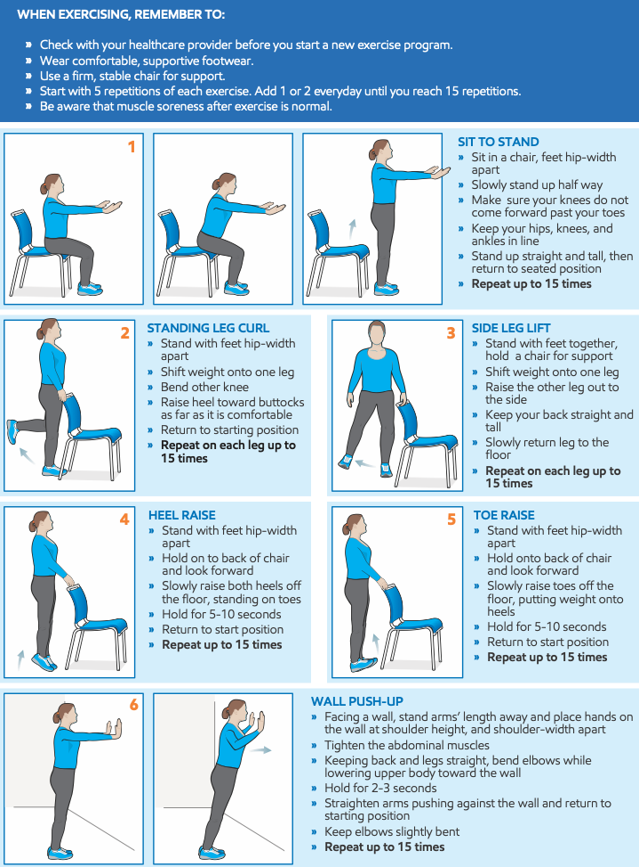
Everyday Exercises for Older Adults

Slide 21
Find out more about preventing a fall at:
findingbalancealberta.ca
Presenter Name
555-123-4567
email@address.com

